Slide 1

Collaborative AI for Adaptive Portfolio Optimization
Transforming investment advisory with Multi-Agent Systems.
Presenters: ARYAN BARNWAL, GAUTAM VEER
Team: Auralis
Domain: GenAI

Slide 2
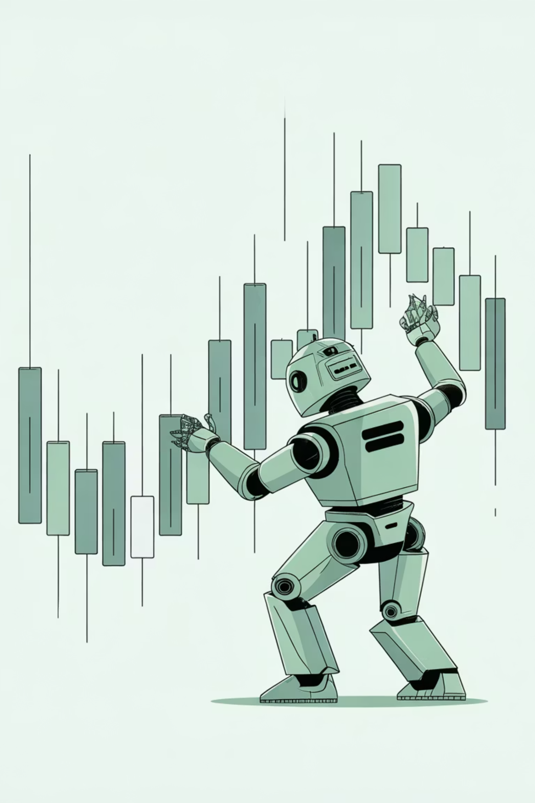
The Limitations of Traditional Investment Models
Dynamic Markets
Static Assumptions
Financial markets are complex, dynamic, and influenced by human behavior and macroeconomics.
Traditional models rely on fixed assumptions, failing to adapt to non-stationary market nature.
Single-Agent RL Flaws
Single-agent systems risk overfitting, underestimating risk, and poor adaptation to regime changes.

Slide 3





Multi-Agent Systems: A Collaborative Solution
Collaborative multi-agent systems mitigate single-agent limitations through collective intelligence.
Central Meta-Controller
Autonomous Agents
Orchestrates collaboration and dynamically integrates agent outputs.
Simulate a team with distinct strategies and risk sensitivities.
Optimized Returns
Enhanced Resilience
Diversifies decision-making for better overall performance.
Improves resilience to tail risks and extreme market events.

Slide 4
Core Problem: Navigating Market Complexity
How can intelligent investment systems dynamically balance return optimization with risk management by leveraging collaborative multi-agent architectures, adaptive coordination, and risk-sensitive learning to operate effectively across multiple market regimes?
Static Risk Modeling
Limited Adaptability
Lack of Coordination
Opaque Logic

Slide 5
Research Gaps in Current DRL Systems
Fragmented Risk Integration
Risk is often post-processed, not a primary learning signal (Han et al., 2024).
Uncoordinated Multi-Agent Design
Models lack collaborative orchestration, leading to conflicting actions (Li et al., 2024).
Limited Meta-Adaptivity
Frameworks like MARS are restricted to specific indices; scalability is unverified (Chen et al., 2025).
Interpretability & Compliance
Need for transparent decision reasoning for institutional adoption and regulation.

Slide 6
CMARS: Specialized Investment Agents
The Collaborative Multi-Agent Risk-Aware System (CMARS) uses diverse agents.
Conservative Agent
Aggressive Agent
Prioritizes capital preservation; penalizes volatility.
Maximizes expected return; high risk tolerance.
Sentiment Agent
Fundamental Agent
Leverages NLP for market sentiment analysis.
Processes macro indicators and company fundamentals.

Slide 7
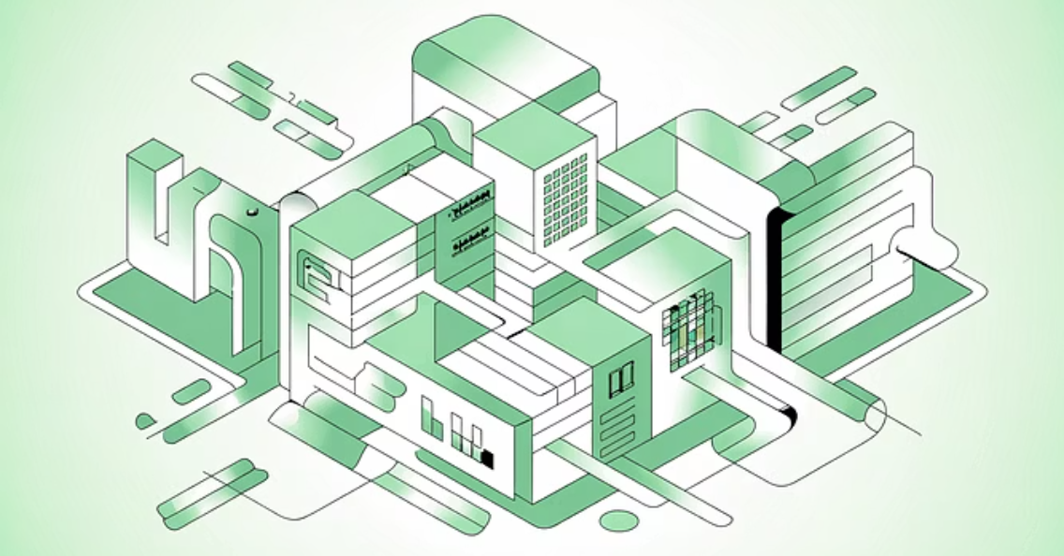

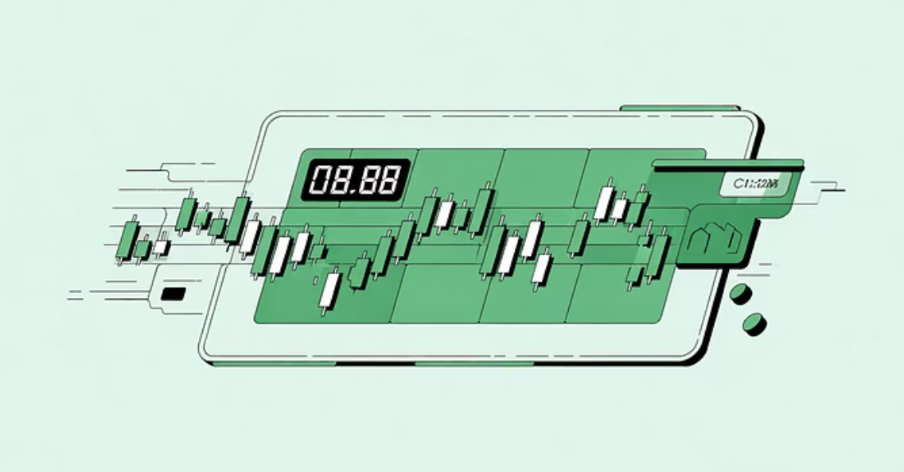
Challenges of Real-World Deployment
Scalability & Resources
Explainability & Compliance
Exponential growth in complexity requires significant computational power.
Difficult to trace decisions back to individual agents (lack of transparency).
Need for efficient algorithms and distributed computing.
Must adhere to strict regulatory standards and provide auditable outputs.

Slide 8
Future Scope: Advancing Financial AI
Hierarchical Multi-Agent Systems
Explainable Collaboration
Layered agents for better coordination and scalability across asset classes.
Using attention-based visualization (e.g., SHAP) to improve interpretability.
Generative Market Simulators
Federated Financial Intelligence
Stress-testing systems with realistic scenarios (diffusion models, LLMs).
Collaboration across institutions while preserving data privacy (Federated Learning).

Slide 9

Thank You for your attension
We are happy to take any Questions

